Slide 1
FairHindiSER: Problem Statement & Motivation
Fair Speech Emotion Recognition for Bilingual Hindi–English Audio
What is SER?
Speech Emotion Recognition (SER) classifies emotional state from raw audio for classes such as Angry, Happy, Neutral, and Sad.
Where is it used?
Mental health monitoring
Call-centre analytics
Human–robot interaction
Two Critical Biases
Language English-centric training misreads
Hindi prosody
Gender Male-skewed corpora create un- equal performance
Our goal:
Balanced bilingual dataset (EN + HI)
Fair five-stage fine-tuning pipeline
AudioTrust-based evaluation
Foundation model:
wav2vec 2.0 – 7-layer CNN + 12 Transformer layers, pre-trained on English audiobooks.
Saumya · Shivam · Suraj · Vidhan

Slide 2
System Architecture
Raw Waveform
16 kHz · mono
CNN Extractor
7-layer 1-D Conv
Transformer Encoder
12 layers · dim 768
Mask- Weighted Pool 768-d vector
FairSER Head
768→512→256→4
Emotion Output
Angry / Happy
/ Neutral / Sad
injects
embeds
loss
LoRA Adapters
rank 16, α32
Layers 8–11 (Q,V)
CLUES Loss cross-lang contrastive λ=0.05, τ =0.10
Focal Loss γ=2, class weights label-smooth 0.15
+
Saumya · Shivam · Suraj · Vidhan

Slide 3
Training Summary
Stage | Key change | Macro F1 | Lang gap | Gender gap
1. Head-only | Train classifier head only; frozen | 0.5506 | 0.0800 | 0.0855
 | backbone baseline
2. LoRA + | Add LoRA on top layers and Focal | 0.6294 | 0.0536 | 0.0291
Focal | Loss for imbalance
3. CLUES | Add cross-language contrastive de- | 0.6515 | 0.0263 | 0.0098
4. Unfreezing | biasing Progressive encoder unfreezing with | 0.7400 | 0.0008 | 0.0060
 | Optuna-tuned learning rates
Takeaway | Key settings kept |  | Final outcome
Stage 2 gives the biggest gain
Stage 3 narrows language bias
Stage 4 gives the best fairness/accuracy trade-off
LoRA on Q/V, layers 8–11
Focal Loss with γ = 2
CLUES contrastive debiasing
English F1: 0.7167
Hindi F1: 0.8117
Balanced multilingual SER
Saumya · Shivam · Suraj · Vidhan

Slide 4
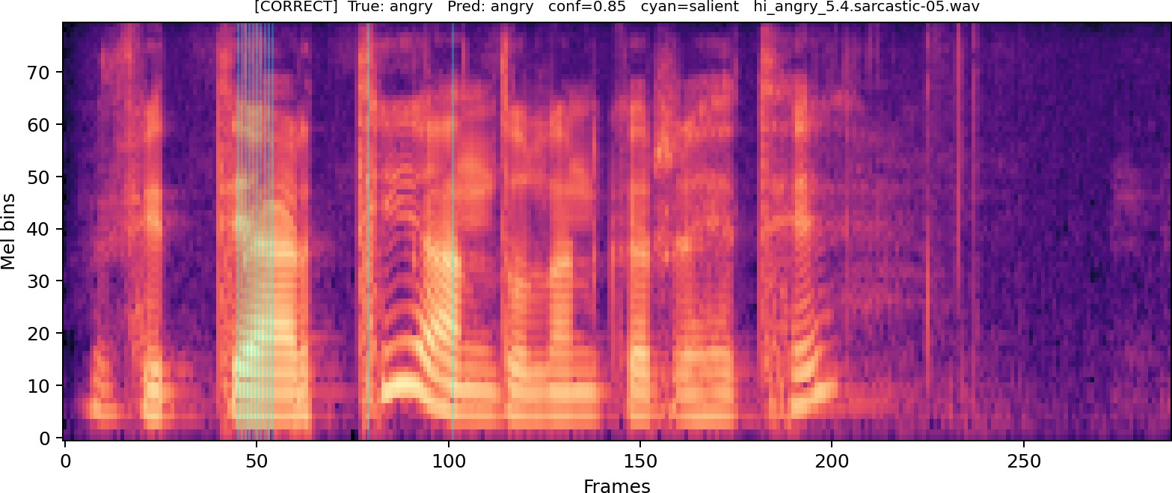
AudioTrust Evaluation, Four Pillars
Dimension
Score
Fairness Robustness Explainability Privacy
0.877 Strong
0.765 Good
0.910 Excellent
0.595 Moderate
Overall 0.787
Integrated Gradients saliency map from the report: attribution mass concentrates on voiced speech regions.
Highlights
Fairness: γ_{gender}=0.898, γ_{lang}=0.901 Robustness: mean drop 0.067, weakest at 10 dB noise
Privacy: MIA AUC 0.590, confidence gap 0.037
Saumya · Shivam · Suraj · Vidhan

Slide 5
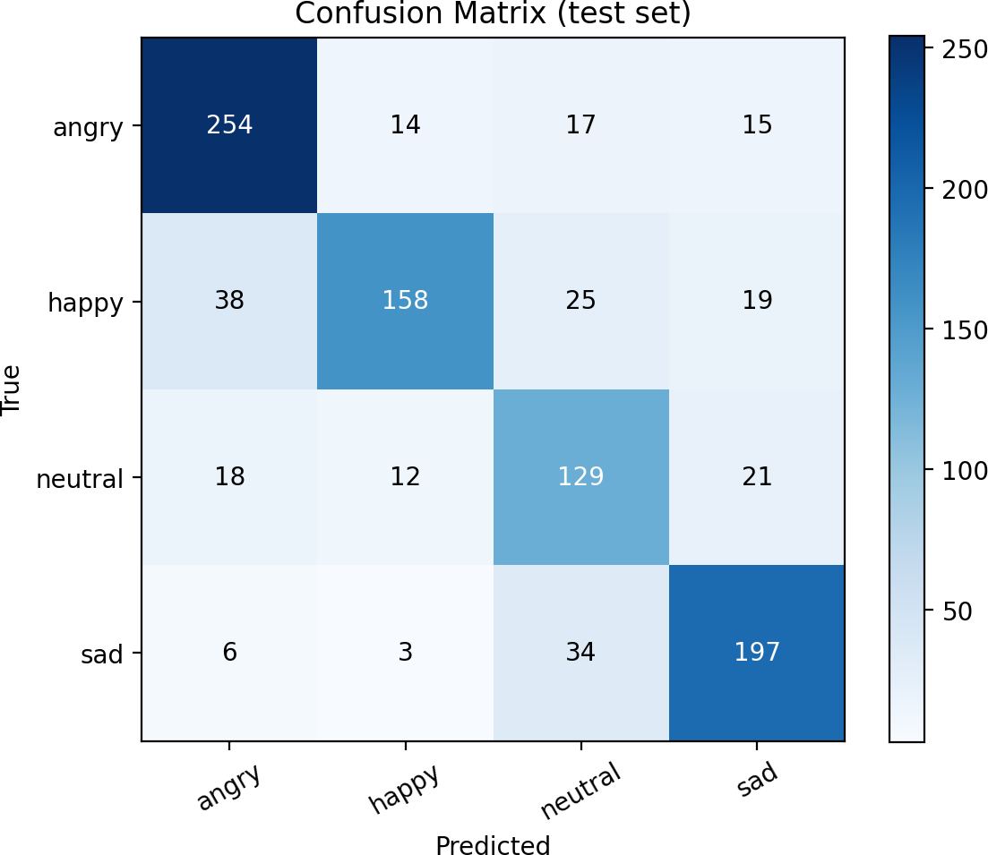
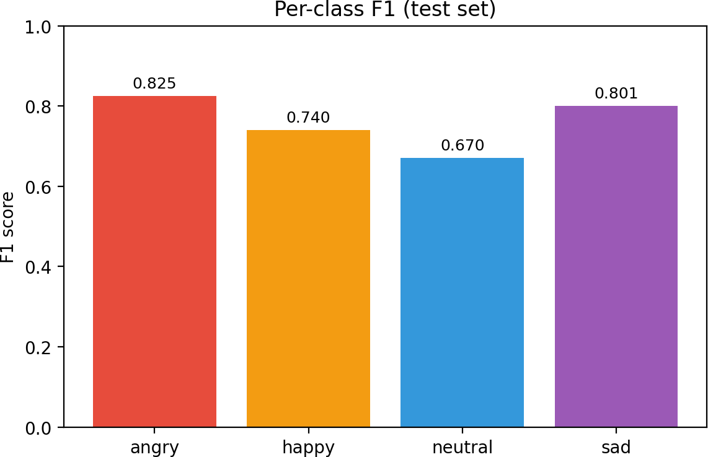
Per-Class Performance
Emotion | F1 | Note
Angry | 0.825 | Clear cues
Happy | 0.740 | Overlap
Neutral | 0.670 | Hardest
Sad | 0.801 | Good separation
Macro F1 | 0.761
Neutral remains the hardest class.
Saumya · Shivam · Suraj · Vidhan

Slide 6
Conclusion
What we achieved
Macro F1 = 0.761 on a balanced 6,400-sample corpus
Gender gap reduced from 0.0855 to 0.0060
Language gap reduced to 0.0008
AudioTrust score: 0.786 What worked best
LoRA for efficient adaptation
CLUES for cross-language fairness
Progressive unfreezing with Optuna
Main Limitation
10 dB SNR noise lowers F1 to 0.46.
A denoising front-end is needed before deployment.
Future Work
Spectral denoising front-end
More languages: Tamil, Bengali
Streaming / real-time inference
FairHindiSER shows that fairness-aware staged tuning reduces demographic gaps without sacrificing quality.
Saumya · Shivam · Suraj · Vidhan

